Slide 1

MENTAL HEALTH ACT
Chapter 45 of the Laws of Barbados
Presenter:
Ms. Laticia A Bourne- Attorney-at-Law
Facilitators:
Mental Hospital
Mr. Tennyson Springer – Director
Mr. David Leacock
Free Powerpoint Templates

Slide 2
Mental Disorder
Section 2
Mental illness, arrested or incomplete development of mind, psychopathic disorder and any other disorder or disability of the mind.

Slide 3
Admission to the Mental Hospital
Section 3
2 Categories of Admission/Patients
Voluntary Involuntary (Admission/Patients)
↕ ↕ ↕ ↕ ↕
Adult Minor Medically Hospital Order Governor
Recommended General Order

Slide 4
Voluntary Admission of An Adult
1
He requests admission himself/someone does so on his behalf
↓
In the form of a written application in a format approved by the Minister (Standard form)
2
The Senior Consultant Psychiatrist (SCP) is of the opinion that the person is or appears to be suffering from a mental disorder

Slide 5
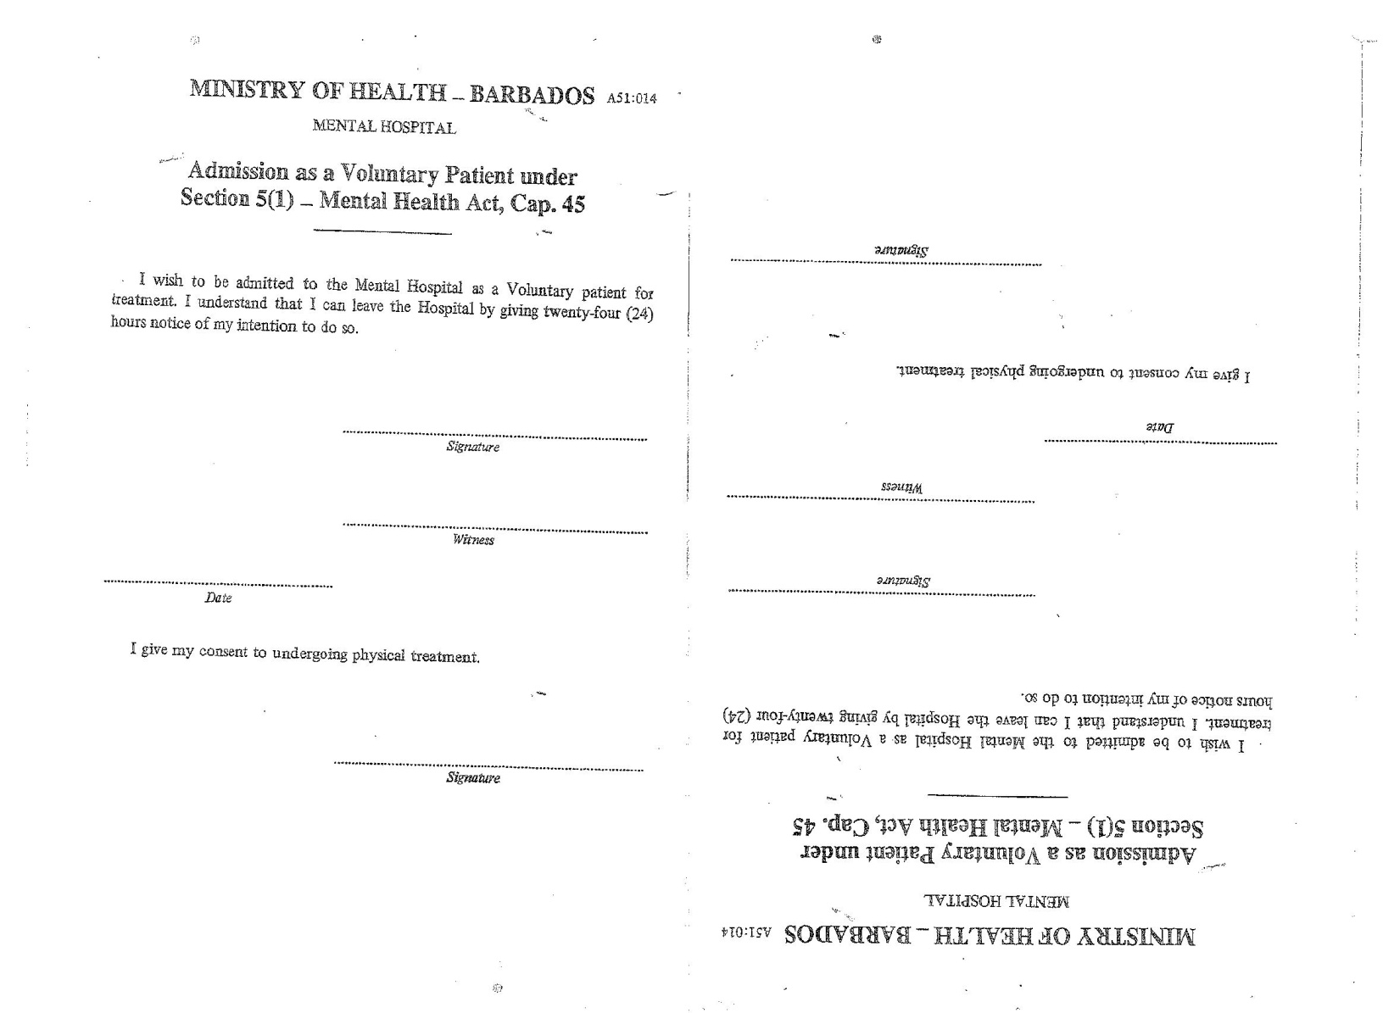
Admission as a Voluntary Patient under Section 5(1)

Slide 6
Voluntary Admission of A Minor
1
Admission is requested for the minor on his behalf by a Parent or Guardian
↓
In the form of a written application in a format approved by the Minister (Standard form)
2
The Senior Consultant Psychiatrist (SCP) is of the opinion that the minor is or appears to be suffering from a mental disorder

Slide 7
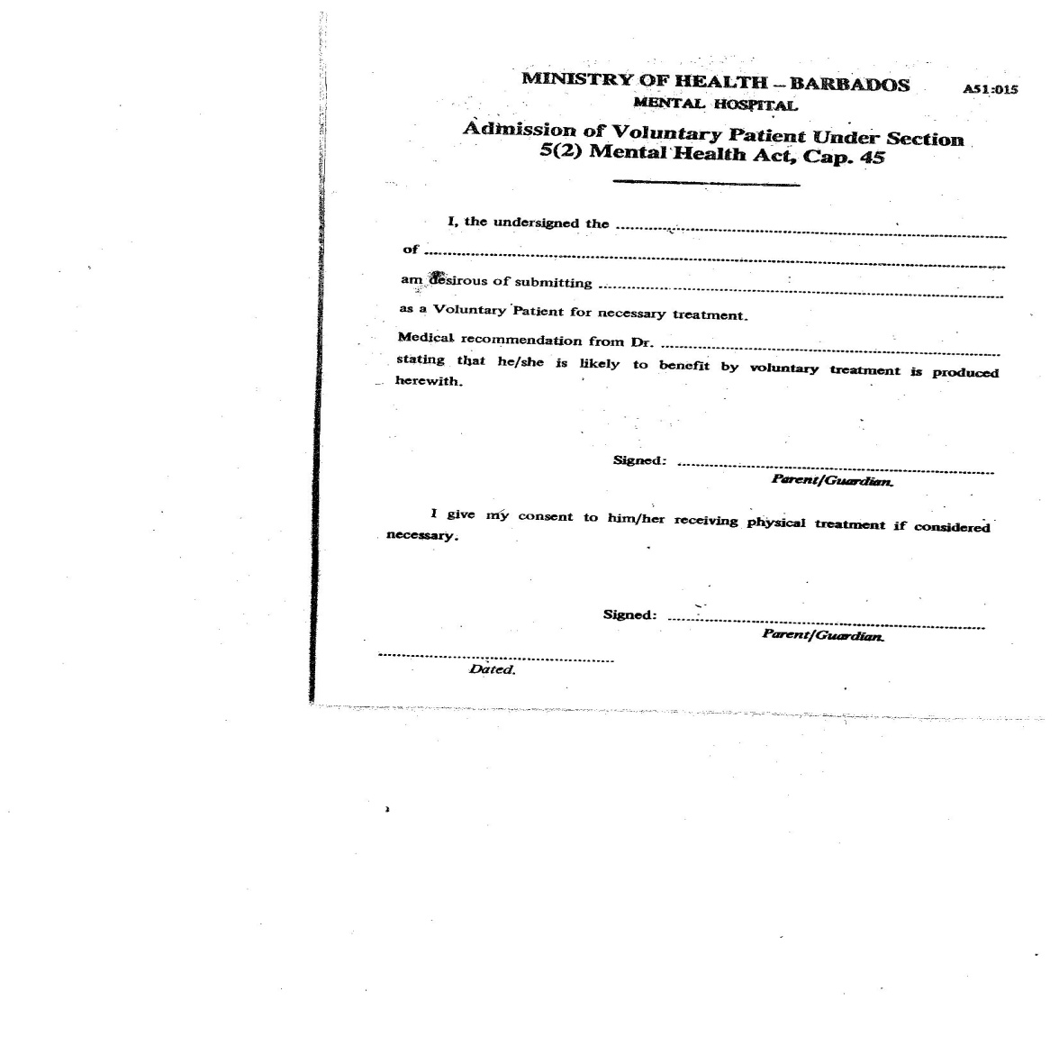
Admission as a Voluntary Patient under Section 5(2)

Slide 8
Admission of a Medically Recommended Person
1
Admission is sought for the person by a parent or guardian (has been interpreted to include a next of kin or a non relative who declares his connection to the person)
↓
In the form of a written application
2
The application must be accompanied by a medical certificate signed by 2 medical practitioners one of whom may be employed by the admitting hospital but the two medical practitioners must not bear any affinity between them (i.e) not be related by work or family ties etc
↓
In the form of a written document in a format approved by the Minister (Standard form)

Slide 9
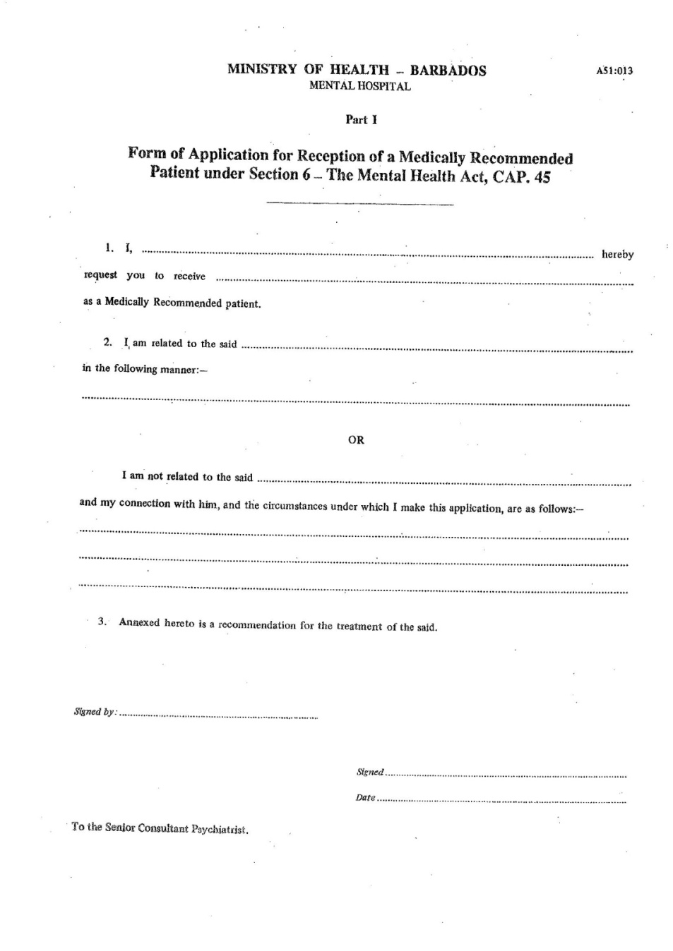
Form of Application for Reception of a Medically Recommended Patient under
Section 6 (Family)

Slide 10
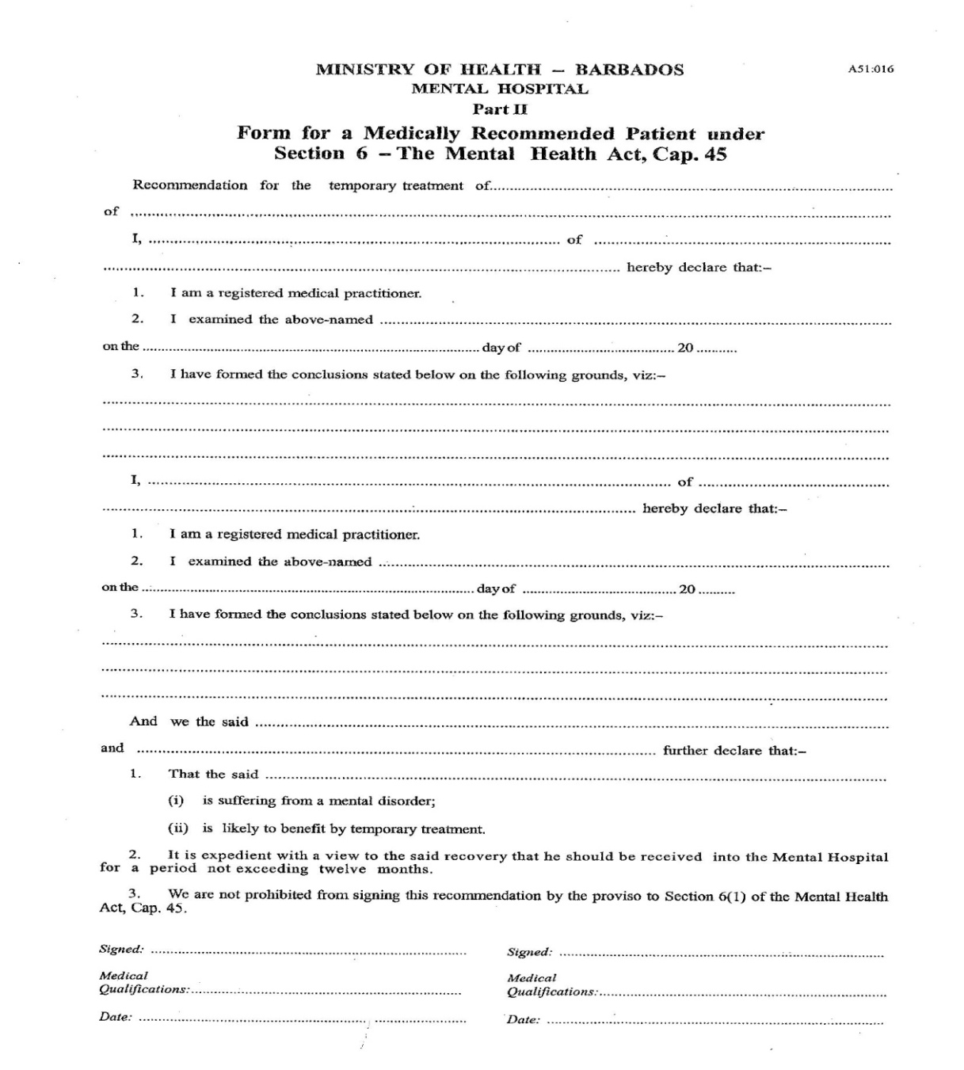
Form of Application for Reception of a Medically Recommended Patient under
Section 6 (Medical Practitioner)

Slide 11
Admission under a
Hospital Order
1. Issued by the Court
Section 7(1)
Where in the opinion of the Court, an accused person charged before it is or appears to be suffering from a mental disorder, the court may order that person to be admitted to a mental hospital for a period not exceeding 8 weeks.
↓
In the form of a warrant from the Court

Slide 12
Admission under a
Hospital Order
2. Emergency Hospital Order Issued by a Mental Health Officer
Section 7(3)
A person who by reason of his general appearance or by
his conduct in conversation, causes a member of the Police
Force who has been so notified by a mental health officer, reasonably to believe that such person is suffering from mental disorder may be taken into custody without a warrant by a member of the Police Force not below the rank of sergeant or by a member
of the Police Force of lower rank acting under the authority of a sergeant or officer of higher rank and conveyed directly to a
mental hospital. ↓
In the form of a written request addressed to the Commissioner of Police from the Mental Health Officer in triplicate (Standard form)

Slide 13
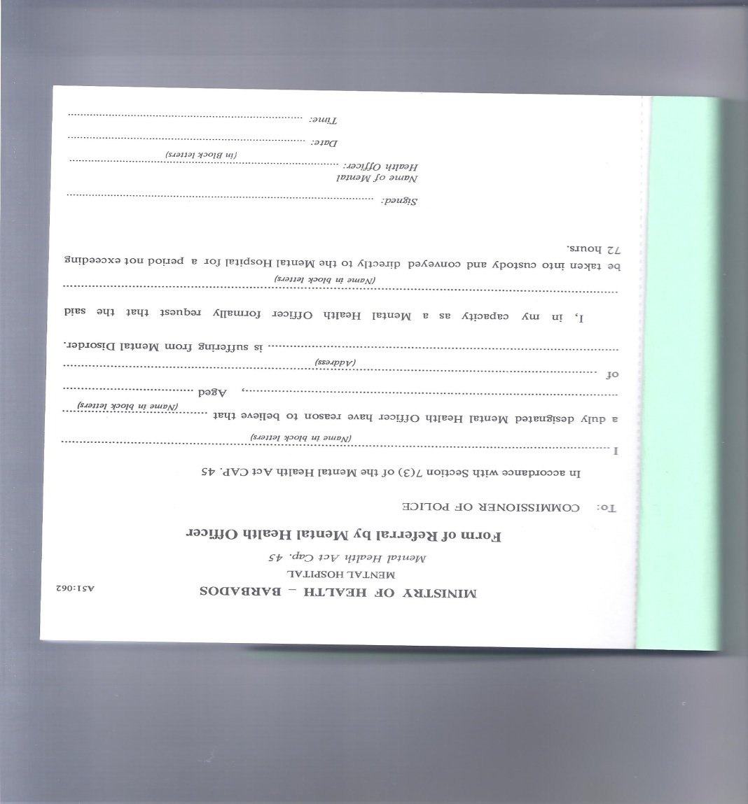
Referral by Mental Health
Officer

Slide 14
Section 7(4)
Where a member of the Police Force is informed by a mental health officer that a
person suspected of being of unsound mind
is in any building or on any premises, whether private or not, that member of the Police force may, if necessary, obtain a warrant and enter such building or premises and take that person into custody.

Slide 15
Section 7(5)
A member of the Police force who takes a
person into custody under subsection (3) or (4)
may elect not to prefer a charge against him;
but may instead convey him directly to a mental hospital and shall in any case, do so within 24
hours from the time of taking him into custody and
as soon as possible thereafter
Inform the relatives and next of kin…;and
Make arrangements for the relatives and next of
kin to communicate with him.

Slide 16
Admission under a
Hospital Order
3. Prison Warrant
Section 8(2), (3)
Where a person charged before a court as referrred to in section 7(1) is transferred under [section 8] subsection (2), arrangements approved by the court shall be made for his security.
↓
In the form of a warrant from the Superintendant of Prisons

Slide 17
Admission under the Governor
General’s Order
‘Her Majesty’s Pleasure’
(Since the introduction of the CCJ to replace the Privy Council as
the final Court of Appeal this has been re-badged to ‘the Court’s Pleasure’)
Section 13(1)
… where a person on trial before the High Court
a) is found unfit to plead; or
b) is found not guilty by reason of insanity; or
c) is found guilty but is suffering from diminished capacity,
the Court shall order him to be detained in a mental hospital
until Her Majesty’s pleasure is known and thereupon the
Governor may give an Order for the safe custody of that
person during such detention.

Slide 18
Institutionalisation → Discharge
Voluntary entitled to be discharged within 24 hours
of providing a written application seeking
discharge; by him or (if a minor) his parent
or guardian
Involuntary
Medically Recommended The certificate expires at the end of 12 months
Hospital Order - (Court Issued) A maximum custody of 56 days/8 weeks
Hospital Order - (Emergency) A maximum admission period of 72 hours
Governor General Order As determined by the Court
Notes:
Conversion from one status to another is possible eg from voluntary to medically recommended and vice versa, from emergency hospital order to medically recommended, from medically recommended to voluntary. The medically recommended status may also be extended by further periods as long as the requisite authorisations are obtained.

Slide 19
Proposals
Recommendation
Reform

Slide 20
Thank You

